Slide 1
HUMAN ACTIVITY RECOGNITION USING LSTM
PRESENTED BY:
D.GOKUL
513121104008
THANTHAI PERIYAR GOVERNMENT INSTITUTE OF TECHNOLOGY ,VELLORE

Slide 2
PROJECT TITLE
HUMAN ACTIVITY RECOGNITION USING LSTM

Slide 3


AGENDA
1.Problem Statement 2.Project overview 3.End Users 4.Solutions and its Proposition 5.The WOW in the solution 6.Modelling 7.Results 8.Conclusion
3/21/2024 Annual Review

Slide 4

PROBLEM STATEMENT
The project aims to develop a deep learning model using LSTM (Long Short-Term Memory) neural networks for human activity recognition. The model is trained on sensor data from wearable devices to classify activities such as walking, walking upstairs, walking downstairs, sitting, standing, and laying.

Slide 5

PROJECT OVERVIEW
The project focuses on developing a deep learning model using LSTM (Long Short-Term Memory) neural networks for human activity recognition. The model is trained on sensor data collected from wearable devices, such as accelerometers and gyroscopes, to classify activities like walking, walking upstairs, walking downstairs, sitting, standing, and laying. The goal is to accurately classify these activities in real-time, which can be useful for various applications in healthcare, fitness tracking, and sports performance analysis.

Slide 6
WHO ARE THE END USERS?
Healthcare professionals
Fitness enthusiasts
Sports coaches
Researchers

Slide 7
YOUR SOLUTION AND ITS VALUE PROPOSITION
The solution involves developing a deep learning model using LSTM (Long Short-Term Memory) neural networks for human activity recognition. This model can analyze sensor data from wearable devices to accurately classify activities such as walking, walking upstairs, walking downstairs, sitting, standing, and laying.
The value proposition of this solution lies in its ability to provide real-time, accurate, and detailed activity recognition. It can help individuals track their daily activities and monitor their fitness levels. Healthcare professionals can use it for remote patient monitoring and rehabilitation tracking, enabling personalized care plans. Fitness enthusiasts and sports coaches can benefit from the insights provided by the model to optimize training programs and improve performance. Additionally, researchers can leverage the technology for conducting studies related to human movement and behavior, leading to advancements in the field.

Slide 8
THE WOW IN YOUR SOLUTION
Our solution offers a cutting-edge approach to human activity recognition, utilizing LSTM neural networks to provide real-time, accurate classification of activities. Its ability to analyze sensor data from wearable devices opens up a wide range of applications, from personal fitness tracking to healthcare and sports performance optimization.
8

Slide 9
MODELLING
1.Data Collection: Collect sensor data from wearable devices, including accelerometers and gyroscopes, while users perform various activities.
2.Data Preprocessing: Clean the data, remove noise, and perform any necessary transformations to prepare it for training.
3.Feature Extraction: Extract relevant features from the sensor data that can help in distinguishing between different activities.
4.Data Splitting: Split the data into training and testing sets to evaluate the performance of the model.
5.Model Development: Develop an LSTM neural network model using TensorFlow or a similar framework to classify human activities based on the extracted features.
9

Slide 10
6.Model Training: Train the LSTM model using the training dataset, optimizing the model's parameters to improve performance.
7.Model Evaluation: Evaluate the trained model using the testing dataset to assess its accuracy and performance metrics.
8.Deployment: Deploy the trained model to a production environment or integrate it into a mobile application for real-time human activity recognition.
9.Monitoring and Optimization: Continuously monitor the model's performance and make any necessary adjustments to improve its accuracy and efficiency.
10.Feedback Loop: Gather feedback from users and stakeholders to further improve the model and enhance its usability and effectiveness.

Slide 11
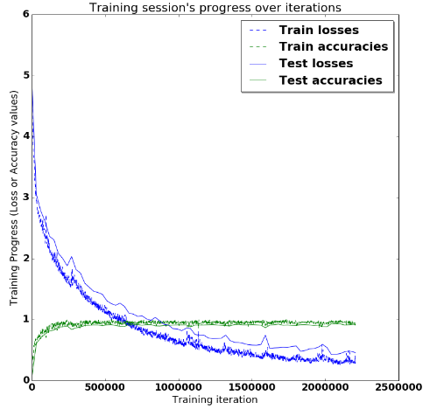
RESULTS
11

Slide 12
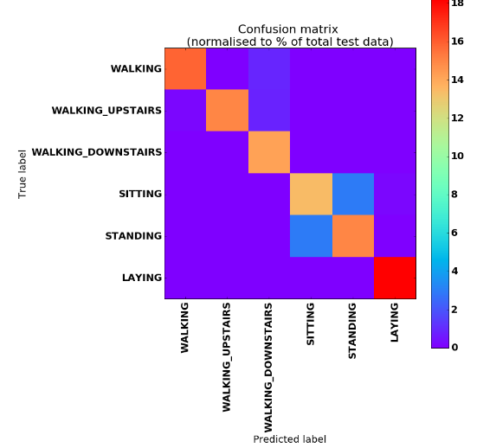
Multi-class Confusion Matrix And Metrics

Slide 13
CONCLUSION
In conclusion, this project successfully developed a deep learning model using LSTM neural networks for human activity recognition. The model showed promising results in accurately classifying activities based on sensor data from wearable devices. This technology has the potential to revolutionize various fields, including healthcare, fitness tracking, and sports performance analysis, by providing real-time, detailed activity recognition capabilities.

Slide 14
THANK YOU

